Slide 1
Build your NB-IOT device with Avnet
AVNET VIETNAM
01. 2018

Slide 2






AVNET CONNECTED IoT ECO-SYSTEM
A Platform for you to START & COMPLETE your IoT Journey
Avnet IoT Cloud
Makers & developers
Prototype
Industrialization
Online Community
& Education Sites
Online Resource Directory for Startups
E-commerce for Prototyping
Total Product Analysis for Manufacturing
Supply Chain
Support
Learn & Design
Create Companies
Pilot
Build
Manufacture Faster
Mass Scale
Production
Avnet is the Only Technology Distributor
with full end-to-end service capability

Slide 3
LPWA Support - ADS Edge-to-Enterprise Solutions
S/N | E2E Reference Design | Target Application
1 | NB/M1 coms module | Utility meters – gas, water and energy
2 | NB/M1 CO₂ sensor | Manhole and waste management
3 | NB PTH sensor | Environment and industrial monitoring
4 | Soil sensor | Agriculture, horticulture, safety
5 | Environment sensor | Environment and industrial monitoring, safety.
6 | Emergency button | Alert button
7 | Water lever meter | Water level monitoring

Slide 4
IoT Device - Design and Build
Technology Selection
Have more than 300 Suppliers
Product Development & Integration
Field Application Team
Avnet Design Service Team
Manufacturing
Support lots of EMS, OEM, ODM partners
Inventory Management & Logistic
Provide best-in-class supply chain services help you reach your goals in a profitable manner

Slide 5

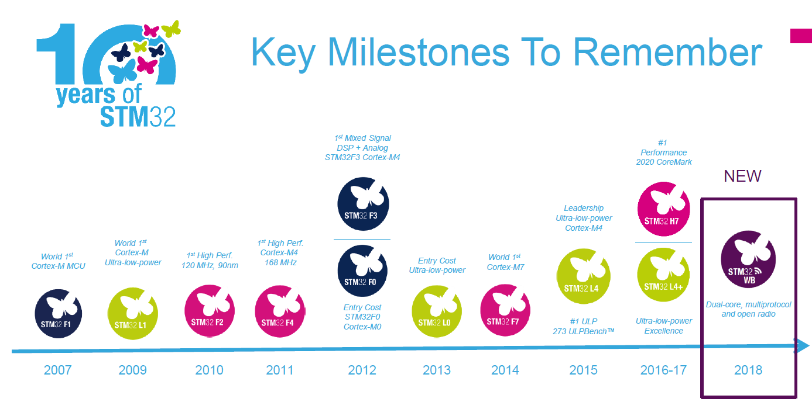
Avnet Partner - STMicroelectronics

Slide 6
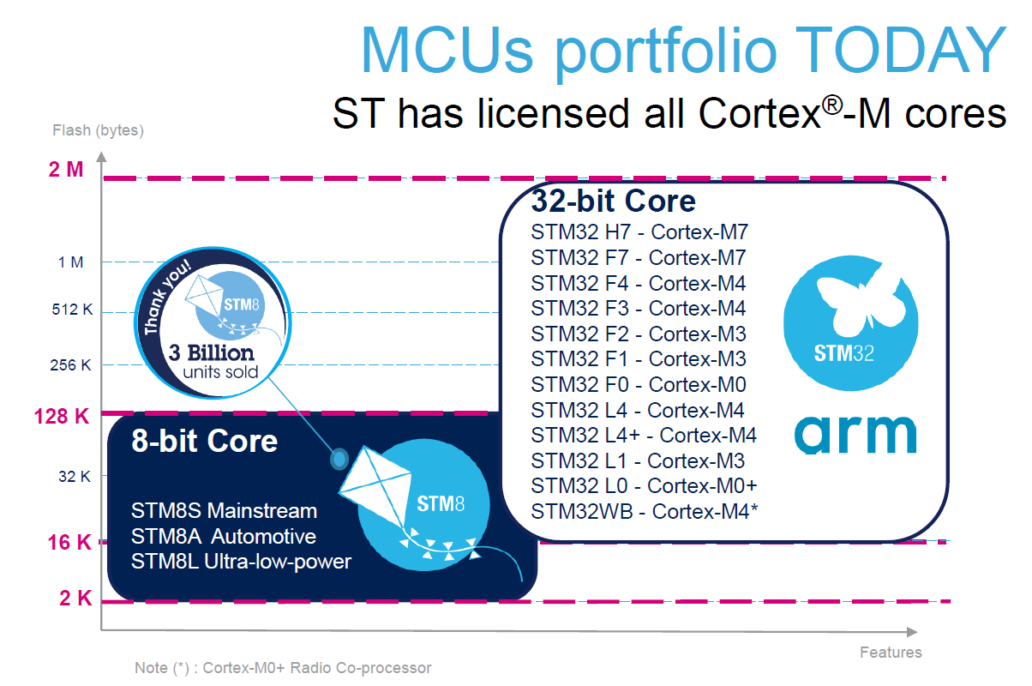
Avnet Partner - STMicroelectronics

Slide 7
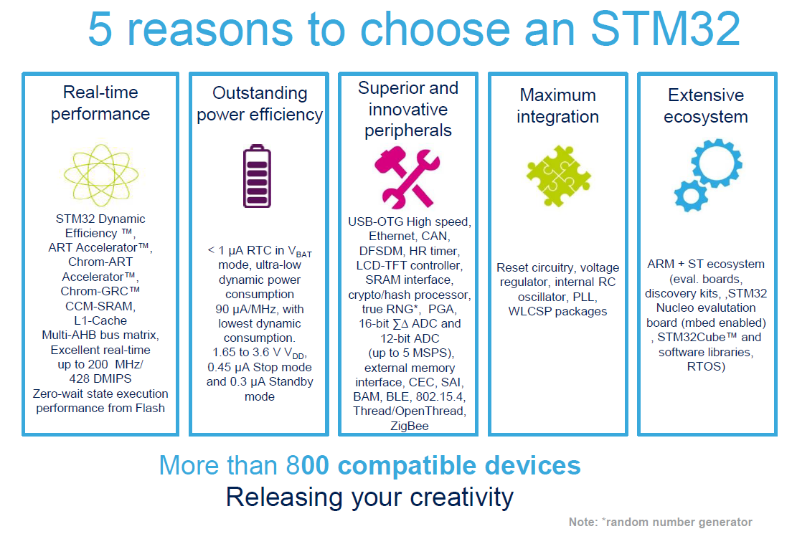
Avnet Partner - STMicroelectronics

